Slide 1
Title:
Comprehensive Analysis of Iris Dataset Using Logistic Regression
Naif Khalaf Almaliki

Slide 2
Introduction:
The Iris dataset stands as a cornerstone in the realm of machine learning, representing a pivotal dataset that has transcended time. Collected by biologist and statistician Ronald A. Fisher in 1936, the dataset encapsulates measurements of sepal and petal attributes for three distinct species of iris flowers: setosa, versicolor, and virginica.
Its significance lies in its simplicity and effectiveness as a benchmark for various machine learning algorithms, offering a perfect starting point for those venturing into the field.
Objective Of Analysis:
As we embark on this analysis, our primary objective is to leverage the power of logistic regression to classify iris species within the renowned Iris dataset. The aim is to explore how this well-established algorithm can discern distinct patterns in sepal and petal measurements, ultimately providing accurate predictions for the three iris species: setosa, versicolor, and virginica.
By employing logistic regression, we seek to demystify the classification process and gain valuable insights into its effectiveness in handling this real-world botanical classification challenge.

Slide 3
Iris Dataset Overview
Dataset Source:
The dataset at the core of our exploration is sourced from scikit-learn's built-in datasets. This widely-used machine learning library offers a seamless and readily accessible collection of datasets, and the Iris dataset is a prominent inclusion.
Structure and Key Attributes:
The dataset encapsulates crucial measurements of sepal and petal characteristics for a total of 150 iris flowers. Each observation is characterized by four features: sepal length, sepal width, petal length, and petal width. These attributes serve as the foundation for our logistic regression-based classification.
Iris Species:
The dataset revolves around three distinct iris species: setosa, versicolor, and virginica. Each species is characterized by unique combinations of sepal and petal measurements. This trinity of iris species not only defines the dataset's complexity but also lays the groundwork for our logistic regression model's classification task. Understanding the distribution and nuances of these species within the dataset is pivotal for the success of our analysis.

Slide 4
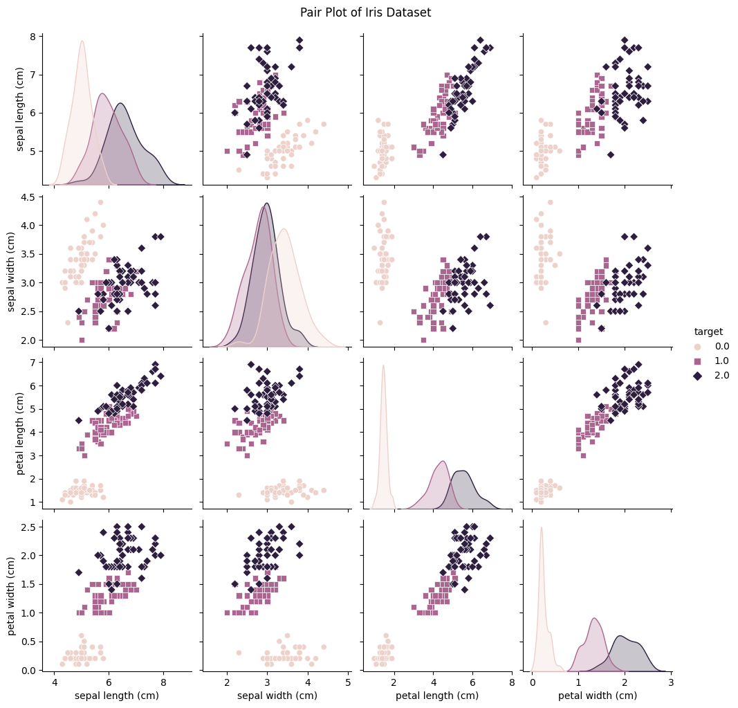
Exploratory Data Analysis (EDA)
Visualizing Insights:
Our EDA journey unfolds through a series of key visualizations. Pair plots, bar plots, violin plots, and box plots emerge as powerful tools, allowing us to distill meaningful insights from the dataset. These visualizations serve as windows into the underlying patterns and relationships that exist between the features.
Pair Plots:
The pair plot, crafted with the aid of seaborn, presents a comprehensive view of feature interactions. Each point in the plot represents an observation, color-coded by the corresponding iris species (setosa, versicolor, or virginica). This visualization not only reveals potential separability but also provides an initial glimpse into the clustering behavior of iris species.

Slide 5
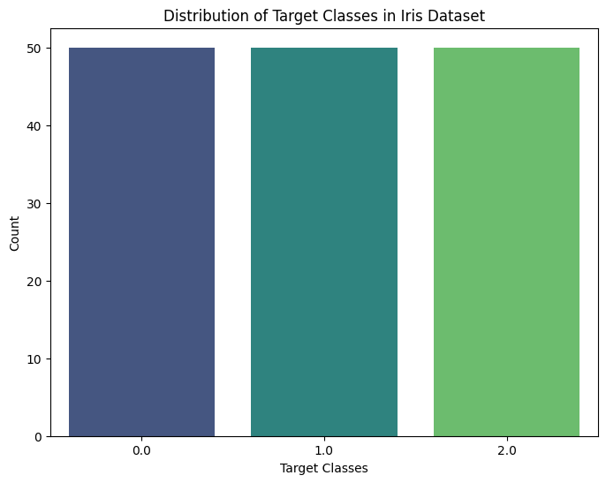
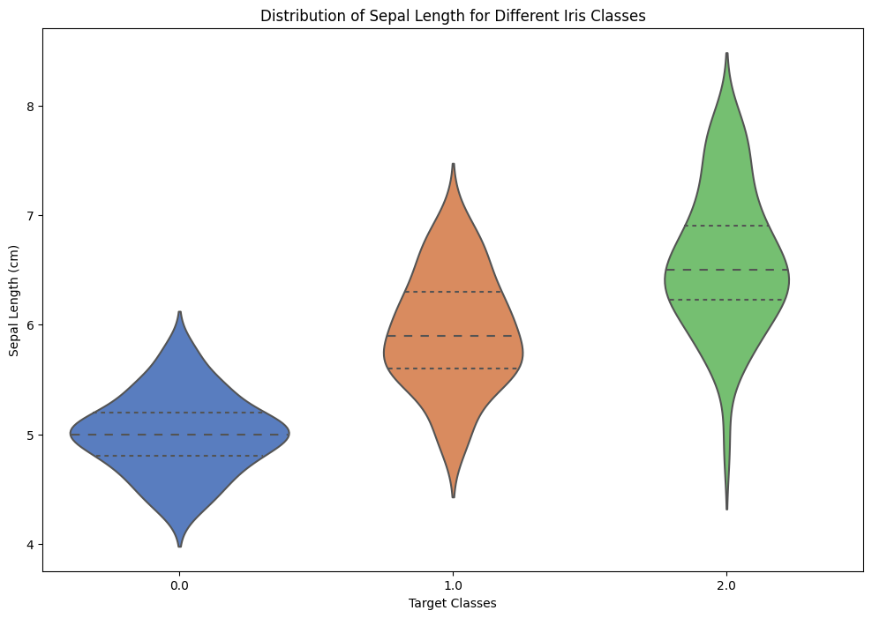
Bar Plots:
Bar plots illuminate the distribution of target classes, emphasizing the balance or imbalance within the dataset. This understanding is pivotal for comprehending the dataset's composition and its implications for the subsequent classification task.
Violin and Box Plots:
Violin and box plots delve into the distribution of sepal and petal measurements across different iris species. These visualizations not only highlight central tendencies but also bring attention to potential outliers and variations within each class. Understanding these nuances is crucial for informed decision-making during model training.

Slide 6
Data Preparation and Model Training
Dataset Splitting:
The journey begins with the strategic division of the dataset into training and testing sets. This process, facilitated by the train_test_split function, ensures that our logistic regression model is exposed to distinct subsets of data during training and testing. By doing so, we fortify the model's ability to generalize well to unseen examples, a fundamental characteristic for reliable predictions.
Logistic Regression Model:
Logistic regression, chosen for its simplicity and efficacy in classification tasks, takes center stage as our selected model. This algorithm excels in binary and multiclass classification, making it an ideal choice for our Iris species classification. The model is initiated and rigorously trained on the training set (X_train and y_train), imbibing patterns and relationships embedded within the data.
Importance of Model Training:
Model training stands as a pivotal step in our analytical journey. Through exposure to labeled training data, the logistic regression model refines its internal parameters, learning to discern intricate patterns that define iris species. The accuracy of subsequent predictions is intrinsically tied to the effectiveness of this training process. By emphasizing the importance of model training, we underscore the foundational role it plays in paving the way for accurate and meaningful predictions in our Iris classification endeavor.

Slide 7
Model Evaluation - Individual Predictions
Qualitative Assessment:
The logistic regression model, with an impressive accuracy of 96.67%, demonstrates its prowess in classifying iris species. However, the true depth of its capabilities is revealed when we examine specific predictions made on the X_test dataset.
The array of predictions, such as [0, 0, 0, 1, 2, 0, 0, 2, 1, 1, 2, 2, 1, 1, 0, 2, 2, 2, 2, 0, 0, 0, 1, 0, 0, 0, 0, 2, 0, 1], provides a glimpse into the model's discernment of iris species for individual observations.
Importance of Generalization:
Beyond numerical accuracy, the true litmus test for any model lies in its ability to generalize to previously unseen data. By scrutinizing individual predictions on the test set (X_test), we gain insights into the model's adaptability to real-world scenarios.

Slide 8
Classification Report
Introduction to Classification Report:
The Classification Report serves as our compass for navigating through the model's intricate performance landscape. It encapsulates precision, recall, F1-score, and support metrics, providing a nuanced understanding of how well the model fares across the three iris species: setosa, versicolor, and virginica.
Highlighting Metrics:
Precision: Reflecting the model's accuracy when predicting a specific class, precision ranges from 86% to 100%. Notably, setosa predictions boast perfect precision, indicating a pristine accuracy.
Recall: Illustrating the model's sensitivity to each class, recall values vary, showcasing areas of strength and potential improvement. Versicolor achieves perfect recall, while there's room for enhancement in predicting virginica instances.
F1-score: Harmonizing precision and recall, the F1-score showcases the overall robustness of the model. Values exceeding 90% underscore the model's effectiveness in most scenarios.

Slide 9
Conclusion
Summarizing Key Findings:
Through meticulous data exploration and visualization, we uncovered underlying patterns and relationships within the Iris dataset, offering a holistic view of its characteristics.
The logistic regression model, trained and evaluated with precision, showcased a remarkable accuracy of 97%. Its ability to classify iris species was evident in both numerical metrics and individual predictions.
Reiterating Significance of Logistic Regression:
Logistic regression emerged as a potent tool in the realm of Iris species classification, demonstrating its prowess in handling multiclass scenarios.
Its simplicity and interpretability, coupled with robust performance, make logistic regression an invaluable asset for tasks demanding clear insights and reliable predictions.
Closing Thoughts:
Our journey through the Iris dataset and logistic regression affirms the model's efficacy and provides actionable insights for future enhancements.
This analysis not only contributes to the broader understanding of classification tasks but also showcases the real-world applicability of machine learning techniques in botanical classification challenges.

Slide 10
Q&A
As we conclude this presentation on the comprehensive analysis of the Iris dataset using logistic regression, I now invite you to engage in an open dialogue. Feel free to ask questions, share insights, or explore any aspects of the analysis that pique your interest.

